Slide 1


عيلة رقمية
معاً نصنع مستقبلًا أكثر تطورًا ووعيًا بالتكنولوجيا!

Slide 2
الرؤية
نطمح إلى بناء مجتمع رقمي متكامل، تمتلك فيه كل أسرة مصرية المهارات اللازمة لاستخدام التكنولوجيا بفعالية وأمان، مما يسهم في تحسين جودة الحياة، وتعزيز فرص التعلم والعمل، والمشاركة الفعالة في الاقتصاد الرقمي.
الرسالة
نسعى إلى تمكين الأسرة المصرية من خلال التوعيه بمبادرات مصرالرقمية، والتي تتيح لجميع أفراد الاسرة الاستفادة من التكنولوجيا الحديثة، وتؤهلهم لسوق العمل المتطور، مما يحقق نموًا مستدامًا ويواكب تطلعات رؤية مصر الرقمية.

Slide 3
أهداف الحملة
نشر الوعي بأهمية التعلم الرقمي لكافة الفئات العمرية.
توفير دورات تدريبية متخصصة ضمن مبادرة "مصر الرقمية".
تمكين الأسرة المصرية من الأدوات الرقمية التي تساعدها في تطوير مستقبلها.

Slide 4

الفئات المستهدفة
الأطفال: تحفيزهم على استكشاف البرمجة وأساسيات التكنولوجيا.
الشباب: تمكينهم من المهارات التقنية المطلوبة في سوق العمل.
الآباء والأمهات: مساعدتهم على استخدام التكنولوجيا بفعالية لدعم تعليم أبنائهم وتحسين مهاراتهم المهنية.

Slide 5
Key Partners
Key Activities
Value Proposition
Customer Relationship
Customer Segments
Projects Challenges
Ministry of Communications and Information Technology.
Egypt Digital Community Digital Initiative organizations supporting digital education.
Local tech businesses interested in digital literacy.
Raising awareness about digital transformation.
Conducting training programs and workshops.
Collaborating with relevant entities to promote digital adoption.
Free access to digital learning courses.
Empowering Egyptian families with essential digital skills.
Enhancing career opportunities through digital education.
Easy and convenient learning for all family members
Continuous interaction through digital content and training programs.
Community engagement via social media.
Parents looking to enhance their digital knowledge.
Students and fresh graduates.
Job seekers aiming for digital career opportunities.
Families interested in modern education
Business Model Canvas
Channels
Key Resources
Social media platforms.
Workshops and training sessions.
Video content and online educational materials.
Digital educational content
Marketing and social media team
Social media platforms for outreach
Volunteer trainers and experts
عيلة رقمية
22-Feb-2025
Iteration #1
Cost Structure
Competitors
Revenue Streams
Social media advertising expenses.
Content creation and platform management
Hosting and technical infrastructure costs
Other Government Initiatives
E-learning Platforms
Private Initiatives & Paid Training Programs
Educational Content on Social Media
Self-funded by project organizers
Personal contributions from team members
Organizing workshops and training sessions
Notes:
Summarizing all information in previous slides the in one Canvas

Slide 6
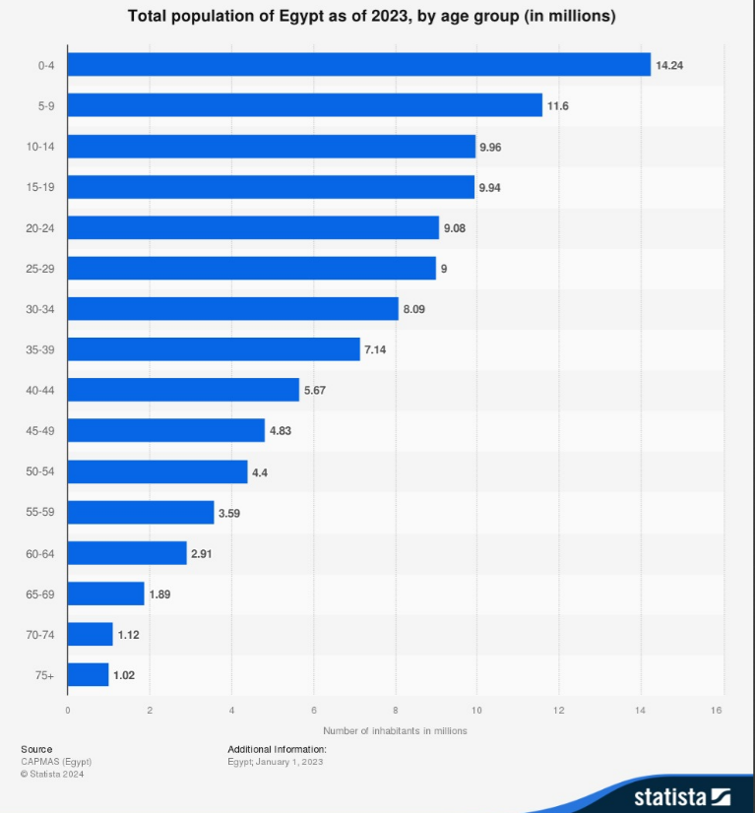
Target Audience and market size
We are targeting people from 10 to 50 years old which presenting 65 Million

Slide 7
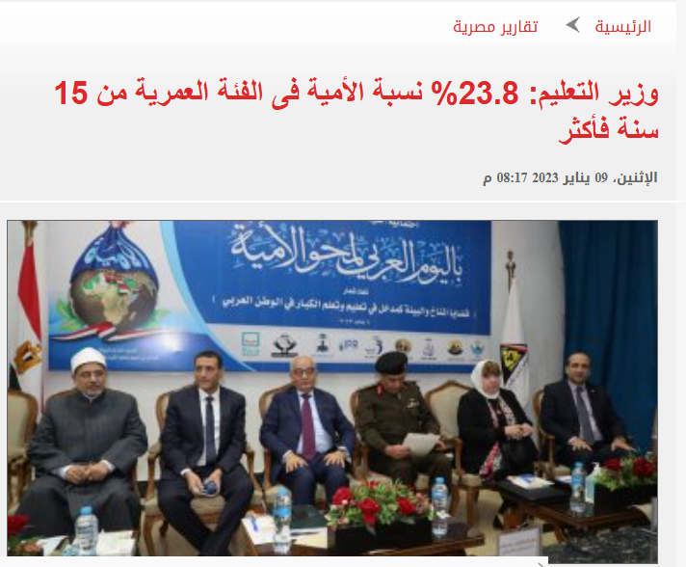
Target Audience and market size
Reference to this trusted survey, so we are targeting 23.8% from 65 Millions which presenting around 50 Millions.

Slide 8
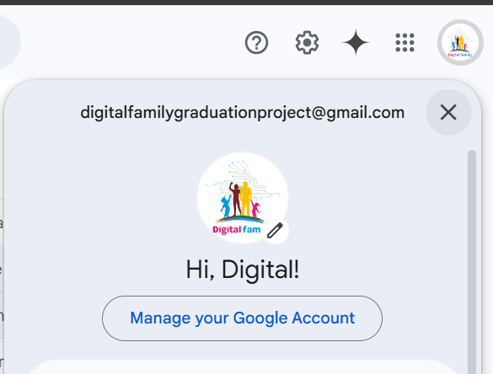
1- Gmail created as below, to start creation remaining platforms
digitalfamilygraduationproject@gmail.com

Slide 9
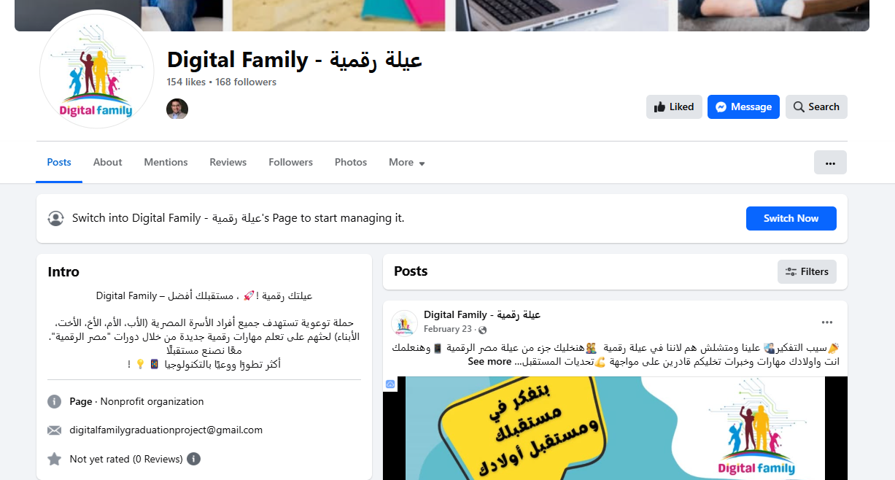
2- Facebook page created with below URL
https://www.facebook.com/DigitalFamilyGraduationProject/

Slide 10
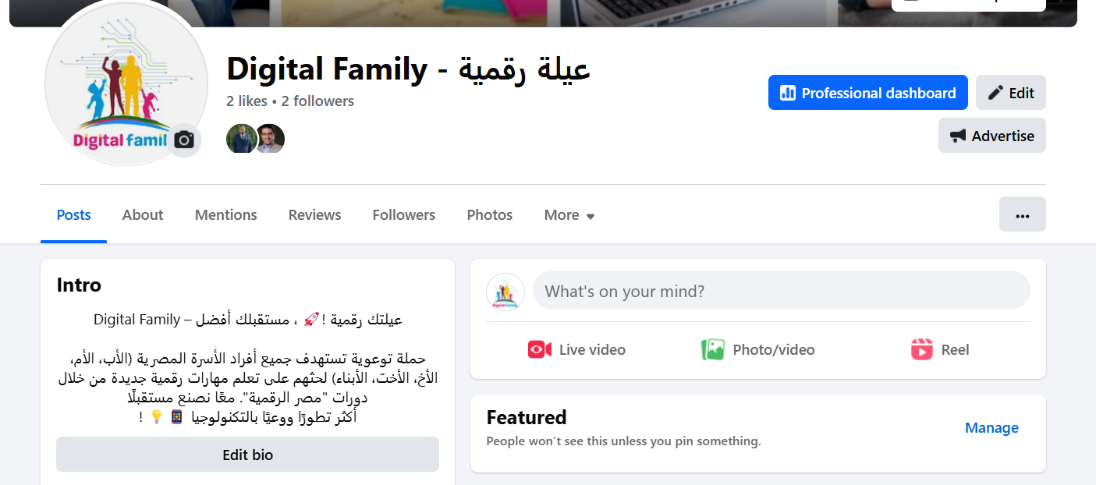
2- Facebook page intro, Bio, and needed data have been filled
https://www.facebook.com/DigitalFamilyGraduationProject/

Slide 11
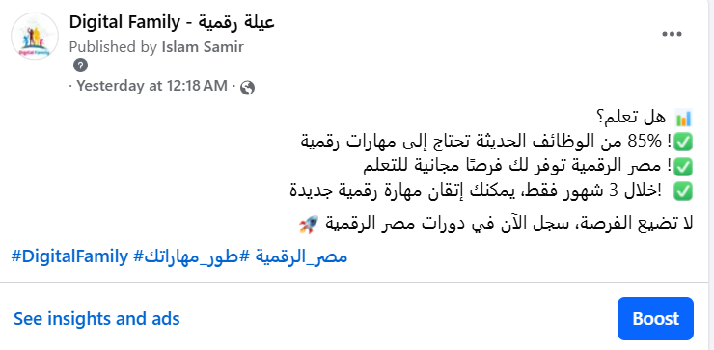
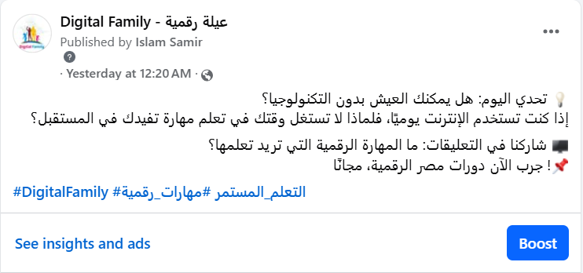
2- Facebook Posts have been published successfully
https://www.facebook.com/DigitalFamilyGraduationProject/

Slide 12
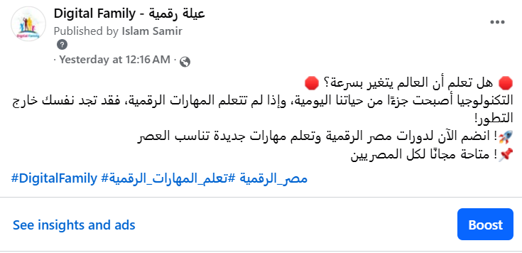
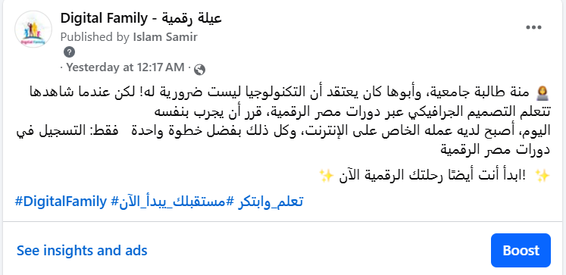
2- Facebook Posts have been published successfully
https://www.facebook.com/DigitalFamilyGraduationProject/

Slide 13
2- Facebook Posts have been published successfully
https://www.facebook.com/DigitalFamilyGraduationProject/

Slide 14
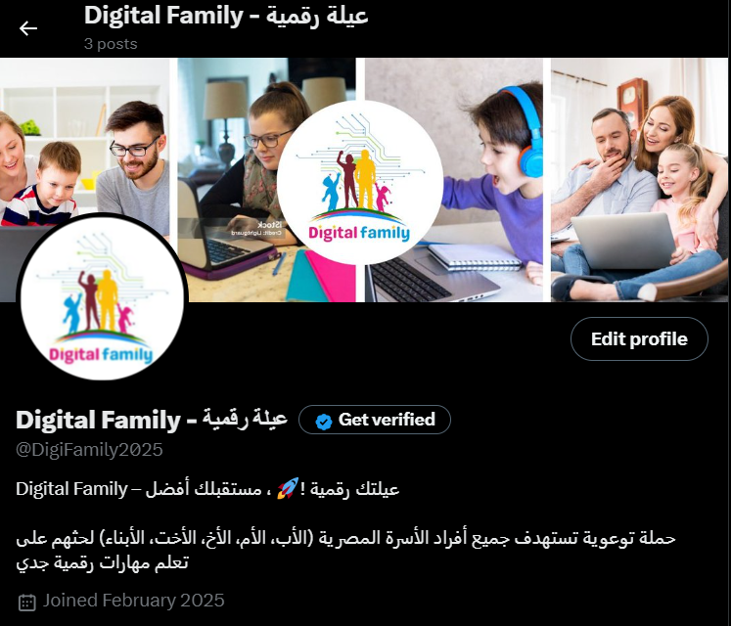
3- X page created with below URL
https://x.com/DigiFamily2025

Slide 15
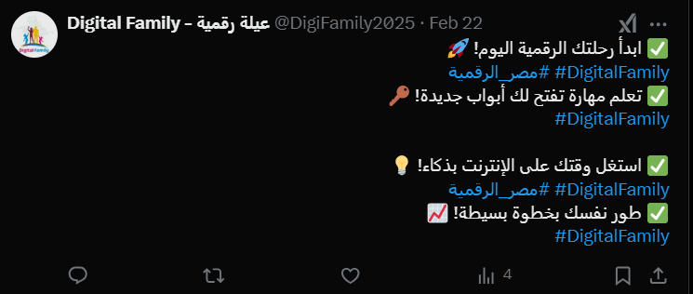
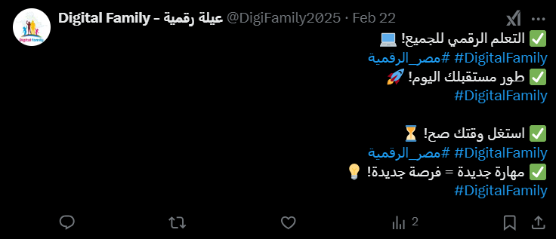
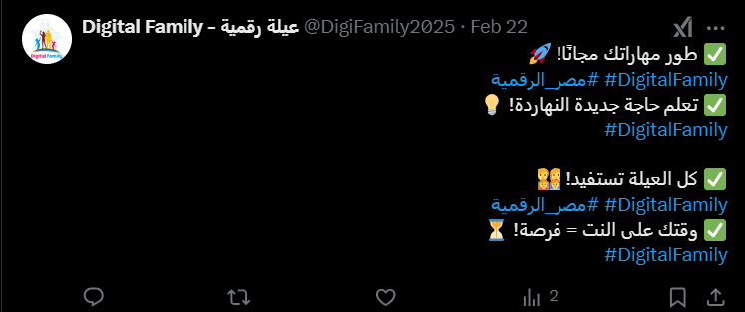
3- X Posts have been published successfully
https://x.com/DigiFamily2025

Slide 16
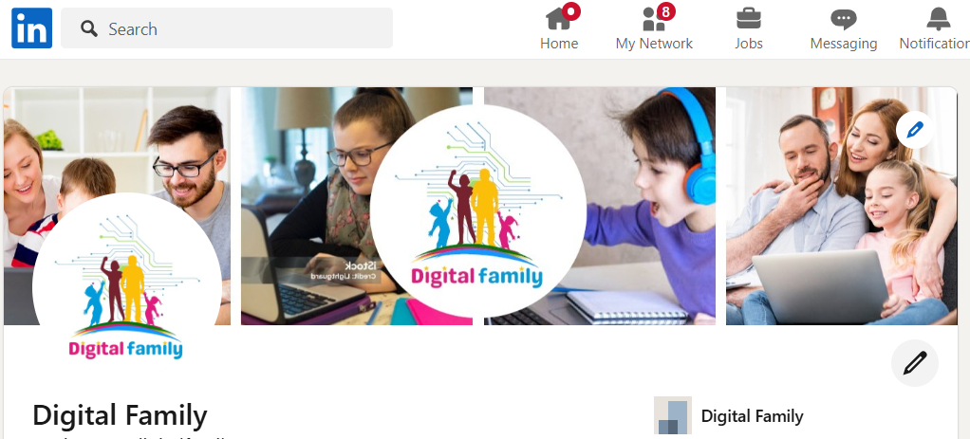
4- LinkedIn platform creation with below URL
https://www.linkedin.com/in/digitalfamily2025/

Slide 17
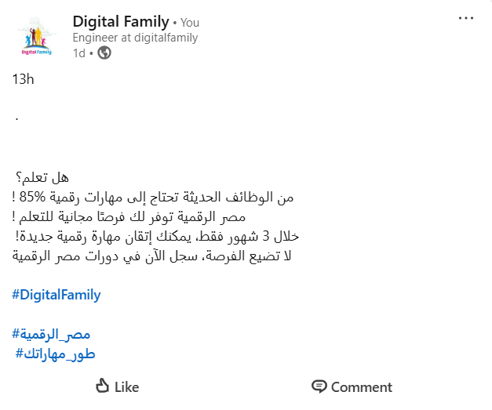
4- LinkedIn Posts have been published successfully
https://www.linkedin.com/in/digitalfamily2025/

Slide 18
4- LinkedIn Posts have been published successfully
https://www.linkedin.com/in/digitalfamily2025/

Slide 19
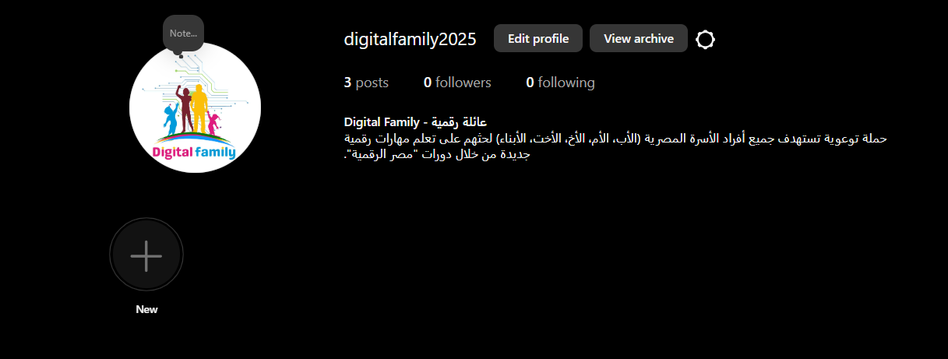
5- Instagram Platform account has been created with below URL
https://www.instagram.com/digitalfamily2025/

Slide 20
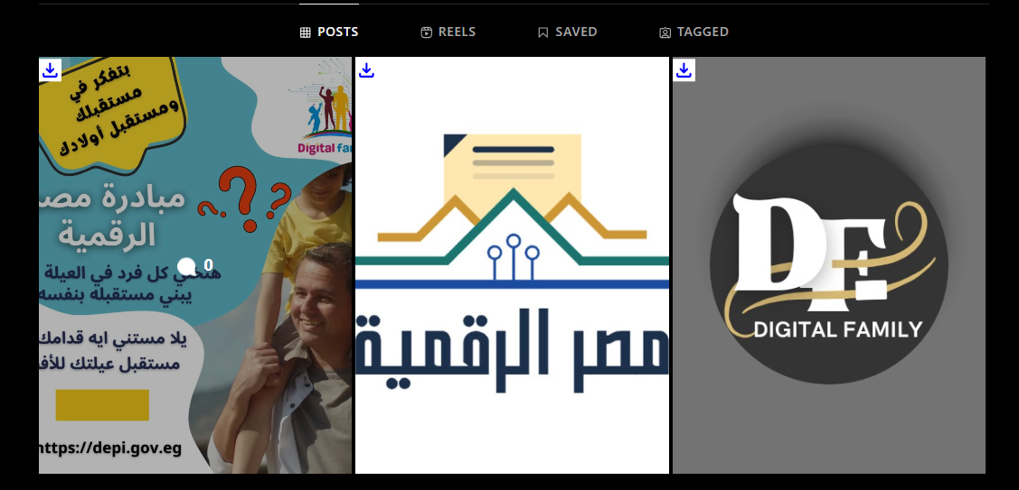
5- Instagram posts (Videos and Pictures have been published successfully.
https://www.instagram.com/digitalfamily2025/

Slide 21
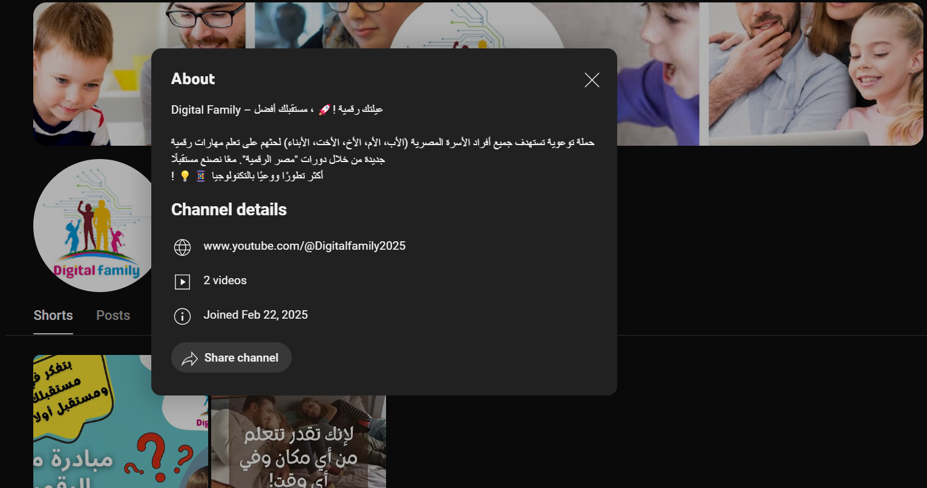
6- YouTube account/Channel has been created with below URL https://www.youtube.com/@Digitalfamily2025

Slide 22
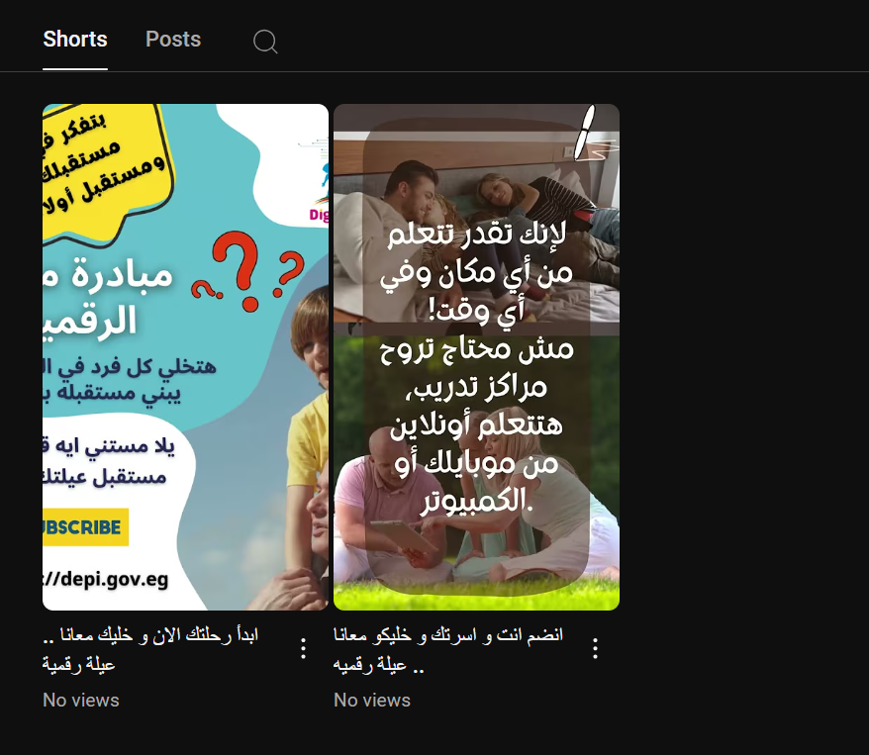
6- YouTube Posts have been published successfully. https://www.youtube.com/@Digitalfamily2025

Slide 23
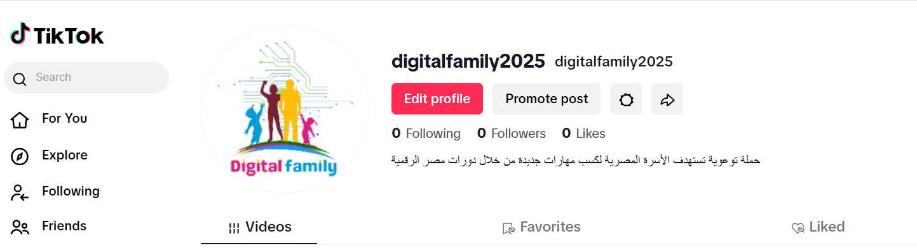
7- TikTok platform account has been created with below URL https://www.tiktok.com/@digitalfamily2025

Slide 24
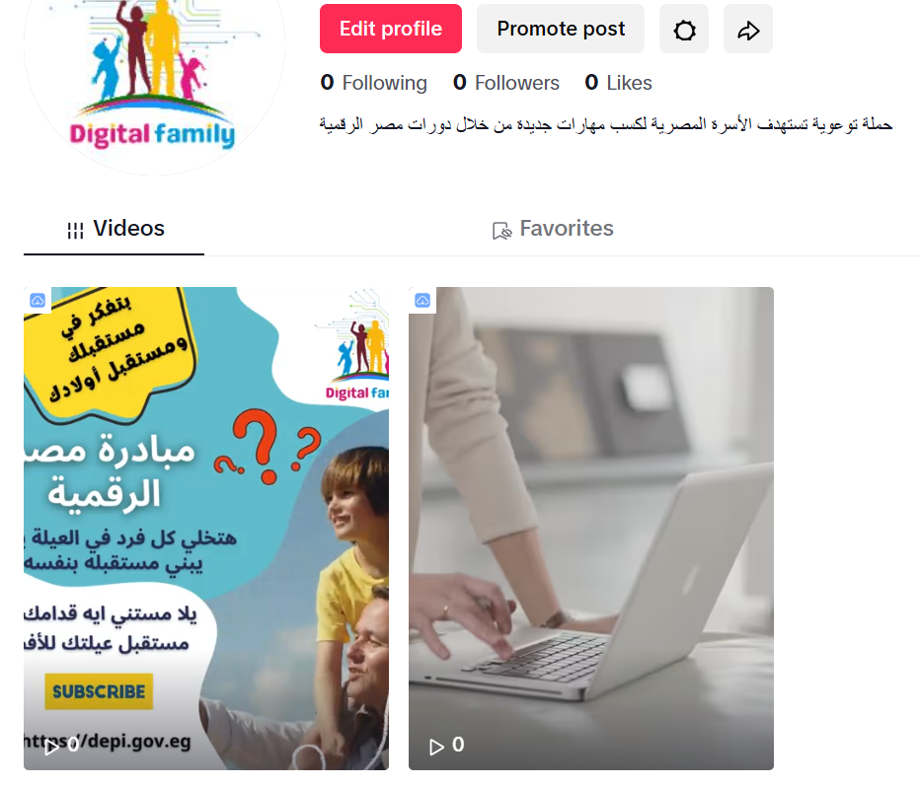
7- TikTok videos have been published successfully https://www.tiktok.com/@digitalfamily2025

Slide 25
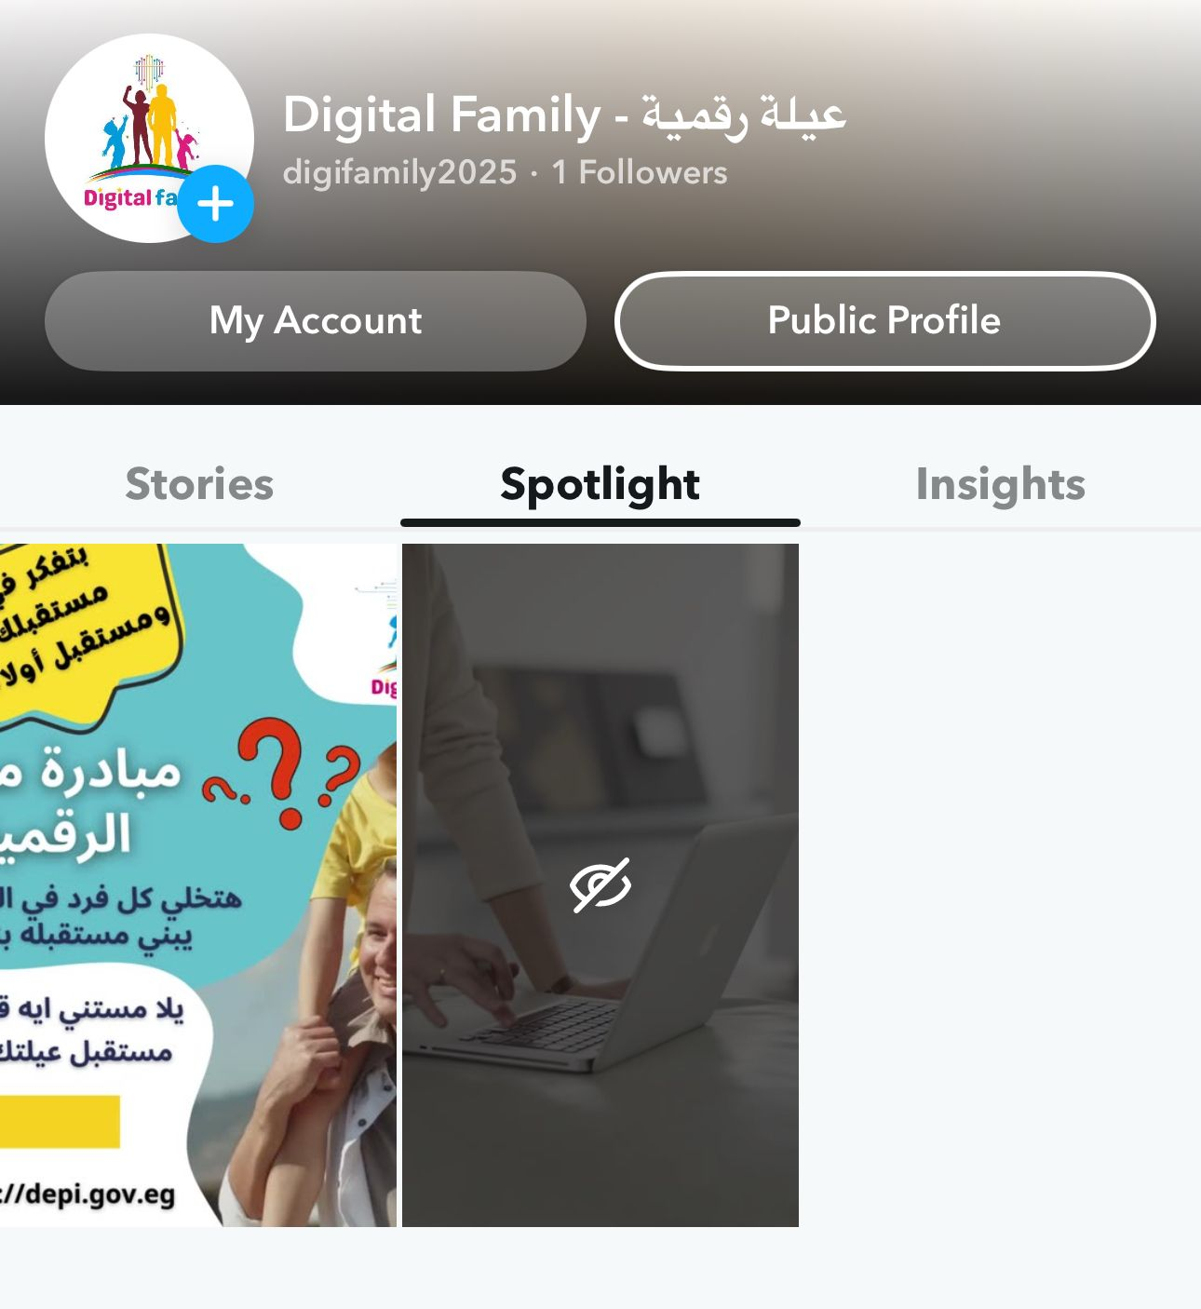
8- Snapchat account has been created successfully, also videos have
been published.

Slide 26
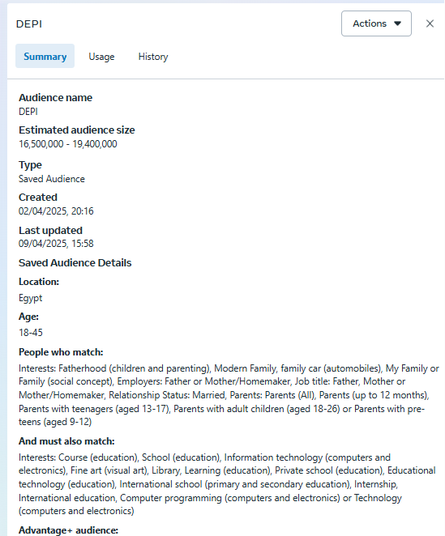
Facebook campaign

Slide 27
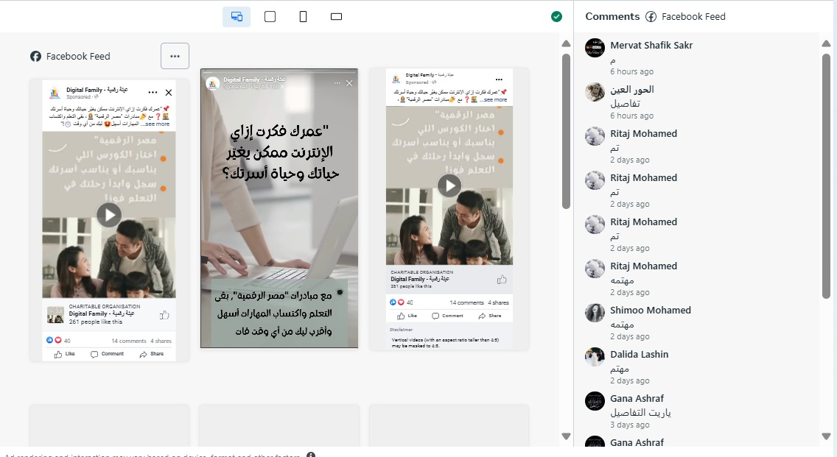
Facebook campaign results

Slide 28
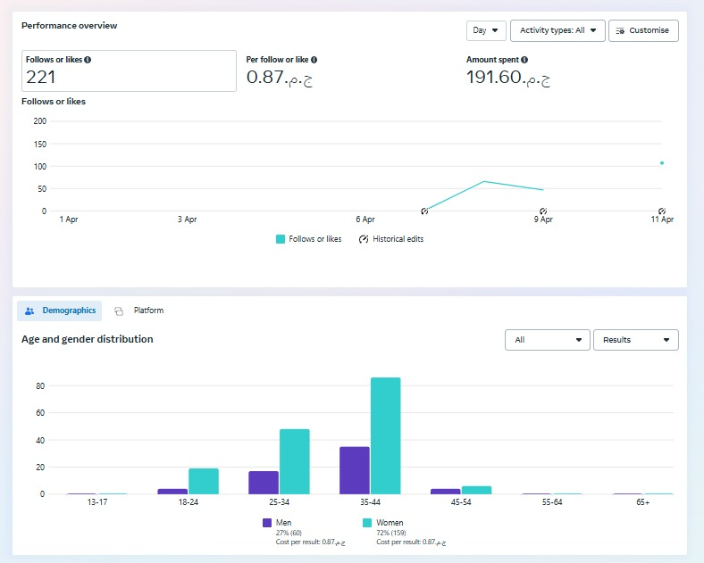
Facebook campaign results

Slide 29
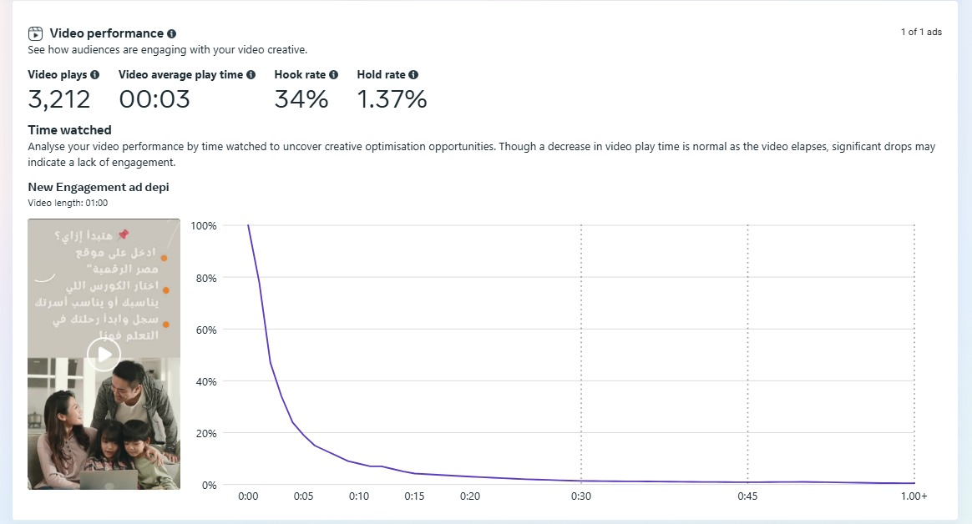
Facebook campaign results

Slide 30
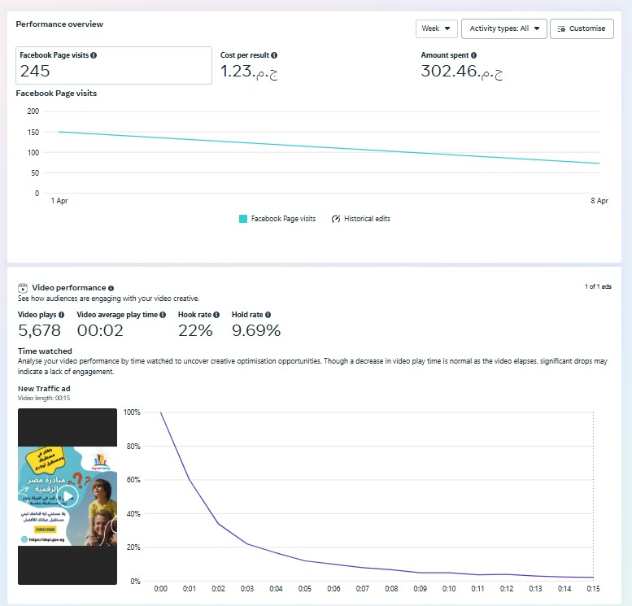
Facebook campaign results

Slide 31
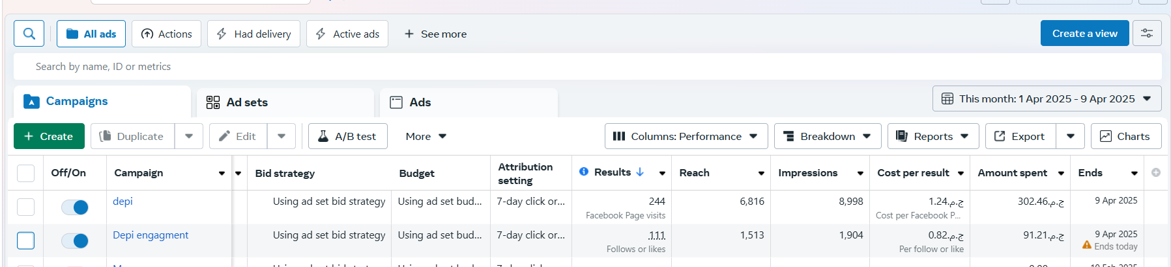
Facebook campaign

Slide 32
Thanks

